Slide 1
Scientific Text Mining and Knowledge Graphs
Meng Jiang and Jingbo Shang
University of Notre Dame University of California, San Diego
mjiang2@nd.edu jshang@ucsd.edu
Notes:
Thank you for the introduction!
Good morning, everyone!
This is Jingbo Shang from UIUC. I’m very excited to share my research with you!
My talk today is mainly about AutoNet. Automated Network Construction from Massive Text Corpora.

Slide 2

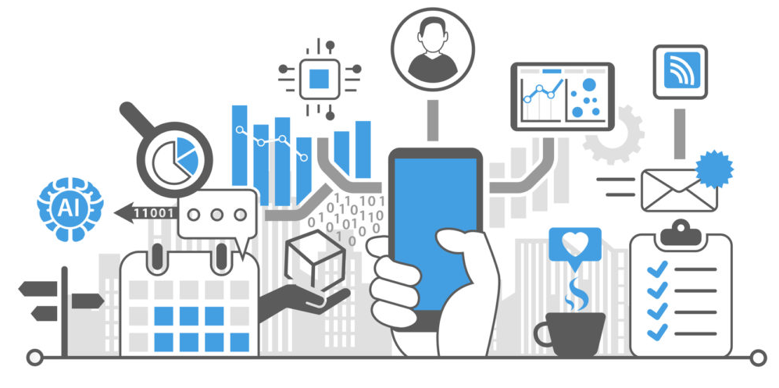
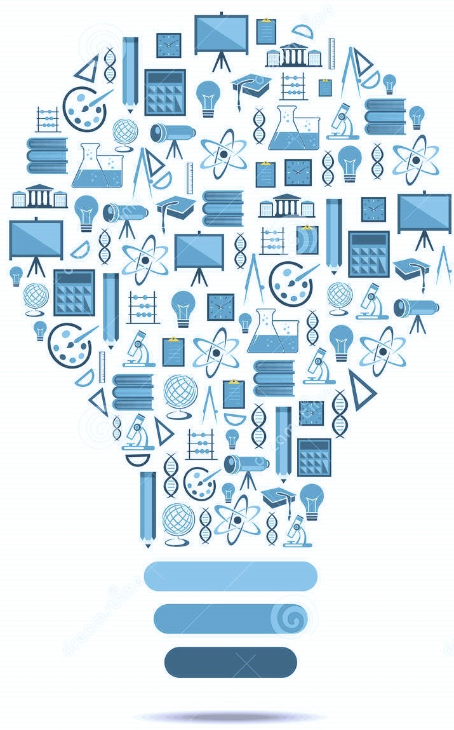
Mining Knowledge from Big Data
(Semi-)Structured
Data
Unstructured
Text Data
Structured Knowledge
& Insights
Big Data
Notes:
As we all know that we are now in the big data era.
Every second, we are generating tons of data. For example, now, in this talk, we are generating data in the forms of audio, picture, video, and text.
It is very important to analyze and understand such big data and then organize them into structured knowledge and insights.
This goal has been pursued by generations of data mining researchers.
There are many data mining methods that focus on extracting knowledge from structured and semi-structured data.
This type of data includes networks, charts, and tables.
On the other hand, there are massive amount of unstructured text data waiting for us.

Slide 3
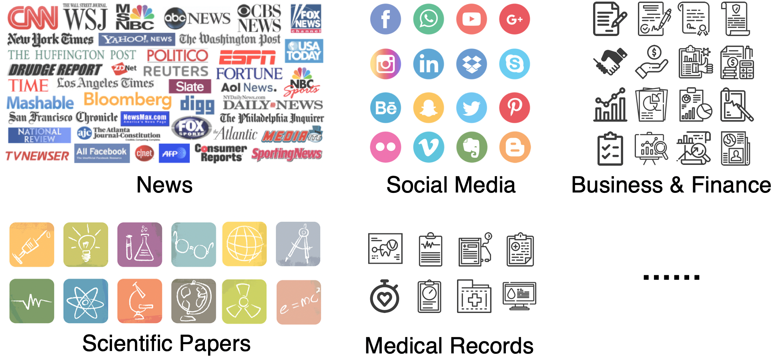
Massive Unstructured Text Data
Notes:
Text data is everywhere in our daily life, including news articles, social media posts, business & finance reports, scientific papers, and medical records.
Their volume itself is massive, but more importantly, it keeps growing!

Slide 4
Massive Unstructured Text Data
Notes:
It’s really difficult to ask human experts to read through all these articles, understand what’s going on, and distill the knowledge.
Even you can recruit a large number of experts, the cost would be expensive.
So it becomes necessary to develop automated models and let machines to digest these information in an efficient and effective way.

Slide 5


Goal: Texts → Knowledge & Insights
Traditional methods rely on extensive annotations from domain experts
Automated Models
Unstructured Text Data
Structured Knowledge
& Insights
This tutorial focuses on an automatic way
“Automatic” – using public knowledge bases only
Notes:
In AutoNet, Our goal is to develop a series of automated models to turn unstructured text data into structured knowledge and insights.
There are many traditional methods can achieve the same goal, but they rely on extensive annotations from domain experts.
The annotation process is time-consuming and expensive, especially in specific domains, such as biomedical and business domains.
If we hire MBAs to annotate raw texts, it will be very expensive.
My AutoNet framework works in an automatic way.
Here, “Automatic” means that there is no additional expert effort other than public knowledge bases.

Slide 6
An Example: BioNLP

Slide 7
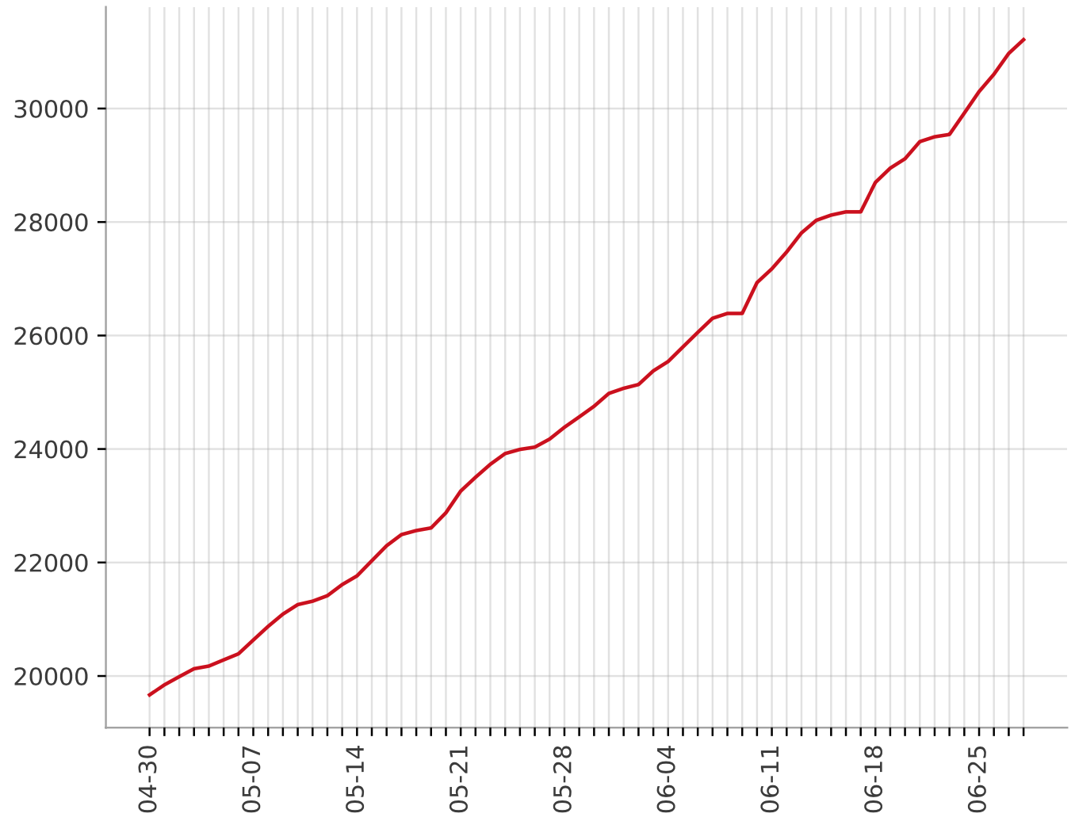
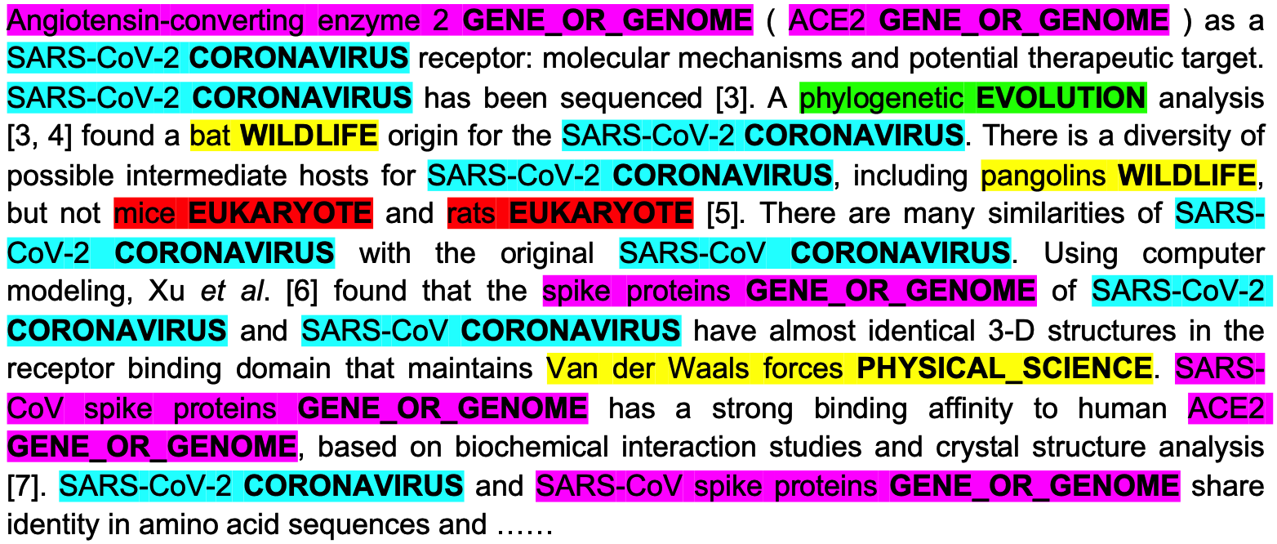
COVID-19 Research
Scientific Named Entity Recognition and Typing
The Growing Number of COVID-19 Papers at PubMed
Wang et al. “COVID-19 Literature Knowledge Graph Construction and Drug Repurposing Report Generation”

Slide 8
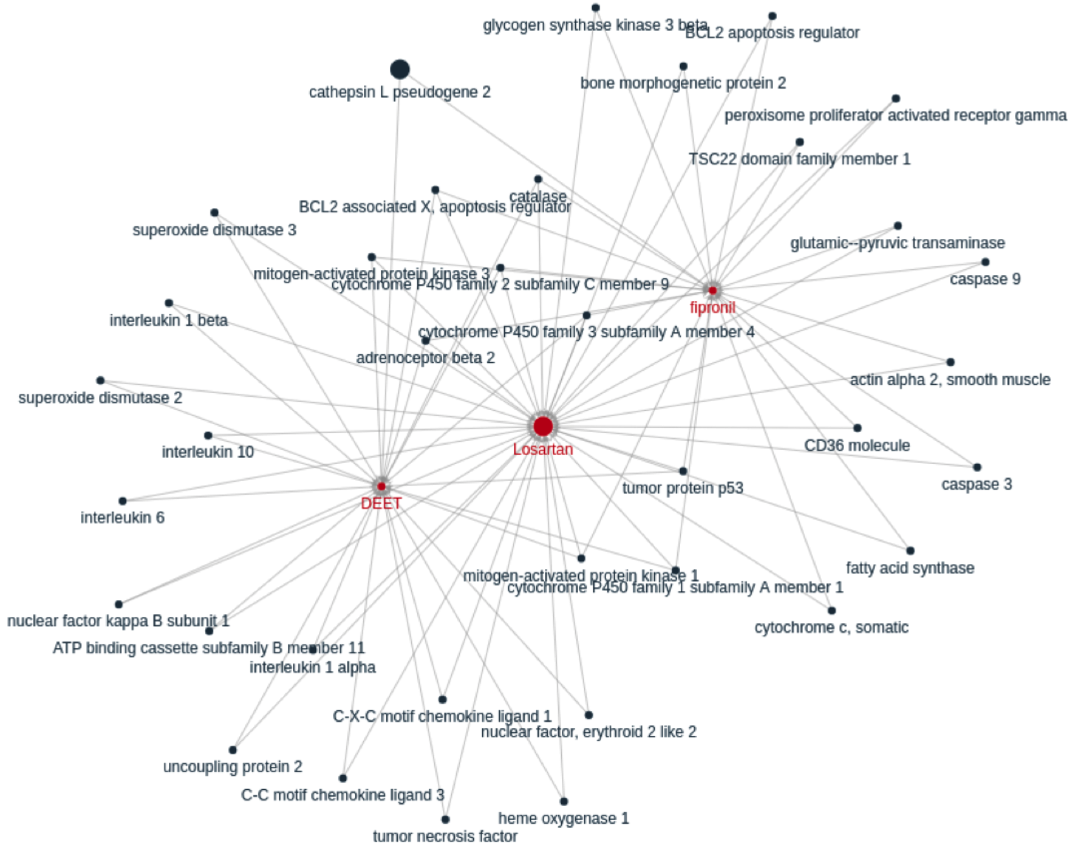
Knowledge Graphs in COVID-19 Research

Slide 9
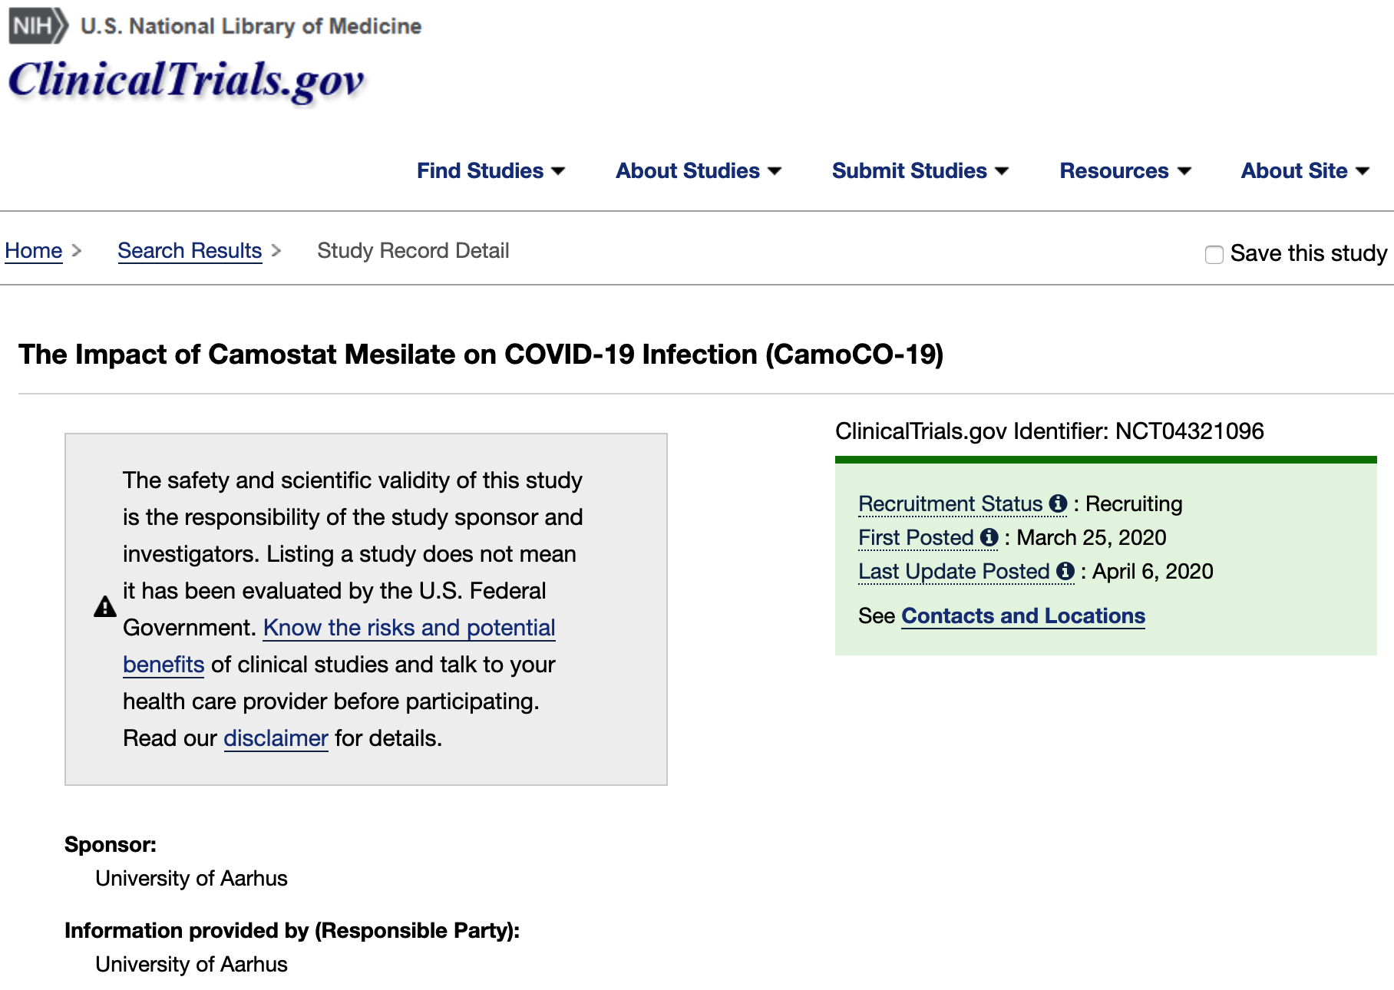
Drug Repurposing
cysteine proteases cathepsin B and L (CatB/L)
Chloroquine
inhibit
inhibitor
inhibit
氯喹
treatment
氯化铵
is
is
camostat mesylate
Caco-2 cells
ammonium
chloride
partially
inhibit
is effective
in preventing
甲磺酸卡莫司他
entry
inhibit
inhibit
?
inhibit
TMPRSS2
drive
spread
ACE2
express
spike protein
(S protein)
express
SARS-COV
infection
of
Vero
E6 cells
be
primary entry cells
is
SARS-COV-2
alveola
type 2 cells
express
lack
cells
entry receptor
enter
cells
not enter
CIDO (ontology)

Slide 10
Two Chapters
Chapter 1: Mining Structures from Scientific Text
Phrase mining
Concept recognition (Named entity recognition)
Language models
Relation and attribute extraction
Conditional statement extraction
Experimental evidence extraction
Chapter 2: Constructing and Learning Scientific Knowledge Graphs
Taxonomy construction
Knowledge graph construction
Learning KG for literature search
Learning KG for scientific text generation
Shang
Jiang
Shang
Jiang

